Slide 1
AWS Simple Storage Service (S3)

Slide 2
What is AWS S3
Amazon Simple Storage Service is storage for the Internet.
Amazon S3 has a simple web services interface that you can use to store and retrieve any amount of data, at any time, from anywhere on the web.
Accessible via simple web service interface.
Use alone or with other service of AWS services.
Amazon S3 provide 99.999999999% [eleven 9’s] durability. If you store 10,000 objects, on average you may lose one of them every 10 million years or so.

Slide 3
AWS S3: Advantages
Create
Buckets
Store data in
Buckets
Download
Data
Permissions
Standard
Interfaces
Transfer
Acceleration

Slide 4

AWS S3 Concepts: Buckets
A bucket is a container for objects stored in Amazon S3.
Every object is contained in a bucket.
Organise the AWS S3 namespace at the highest level.
Each object in Amazon S3 has a unique HTTP URL.
For example, if the object named awsdoc.txt is stored in the “awss3” bucket, then it is addressable using the URL https://s3.amazonaws.com/awss3/awsdoc.txt
You can choose any AWS region that is geographically close to you to optimize latency, minimize costs, or address regulatory requirements.

Slide 5

AWS S3 Concepts: Objects
Objects are fundamental entities stored in S3.
Object is uniquely identified within a bucket by key(name) and a version ID.
Each object in Amazon S3 has a unique HTTP URL.
Objects can be 1 byte to 5 terabytes (TiB).
Objects of differing storage classes can exist in the same bucket.

Slide 6
AWS S3 Concepts: Endpoints
If you create a client by specifying the US East (N. Virginia) Region, it uses the following endpoint to communicate with Amazon S3
<s3.amazonaws.com>
If you create a client by specifying any other AWS Region, each of these regions maps to the region- speciﬁc endpoint:
<s3-<region>.amazonaws.com>
Example : s3-eu-west-1.amazonaws.com (for eu-west-1 region)

Slide 7
AWS S3: Data Consistency Model
Amazon S3 provides read-after-write consistency for PUTS of new objects in your S3 bucket.
Amazon S3 oﬀers eventual consistency for overwrite PUTS and DELETES.
If a PUT request is successful, your data is safely stored. However, information about the changes must replicate across Amazon S3, which can take some time, and so you might observe the following behaviors:
A process writes a new object to Amazon S3 and immediately lists keys within its bucket. Until the change is fully propagated, the object might not appear in the list.
A process replaces an existing object and immediately attempts to read it. Until the change is fully propagated, Amazon S3 might return the prior data.
A process deletes an existing object and immediately attempts to read it. Until the deletion is fully propagated, Amazon S3 might return the deleted data.
A process deletes an existing object and immediately lists keys within its bucket. Until the deletion is fully propagated, Amazon S3 might list the deleted object.

Slide 8
AWS S3: Storage Types

Slide 9
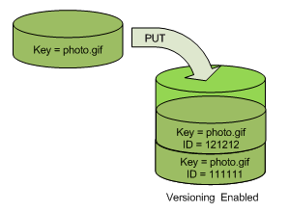
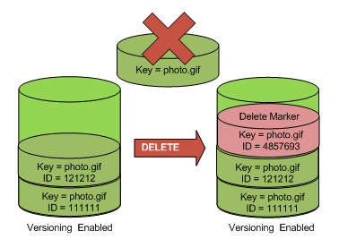
AWS S3: Versioning
When you PUT an object in a versioning-enabled bucket, the noncurrent version is not overwritten.
When a new version of photo.gif is PUT into a bucket that already contains an object with the same name, the original object (ID = 111111) remains in the bucket, Amazon S3 generates a new version ID (121212), and adds the newer version to the bucket.
When you DELETE an object, all versions remain in the bucket and Amazon S3 inserts a delete marker.
The delete marker becomes the current version of the object.
When the current version is a delete marker returns a “404 not found” error.

Slide 10

AWS S3: Hosting a Static Website
You can host a static website on Amazon Simple Storage Service (Amazon S3).
To conﬁgure a bucket for static website hosting, you add a website conﬁguration to your bucket.
To host a static website on Amazon S3, you need only provide the name of the index document.

Slide 11

AWS S3: Data Protection
You can protect data in transit by using encryption.
You have the following options of protecting data at rest in Amazon S3.
Use Server-Side Encryption – You request Amazon S3 to encrypt your object before saving it on disks in its data centers and decrypt it when you download the objects.
Use Client-Side Encryption – You can encrypt data client-side and upload the encrypted data to Amazon S3.

Slide 12
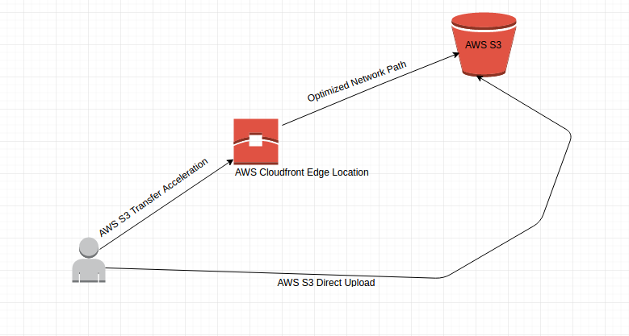
AWS S3: Transfer Acceleration
Amazon S3 Transfer Acceleration enables fast, easy, and secure transfers of ﬁles.
Transfer Acceleration takes advantage of Amazon CloudFront’s globally distributed edge locations.
When using Transfer Acceleration, additional data transfer charges may apply.
After enabling Amazon S3 Transfer Acceleration feature a new name will be generated.
Using the Transfer Acceleration, allows to speed up upload by multiple times.
Example,
If the bucket’s initial name was mybucket.s3.amazonaws.com
The new one will be mybucket.s3-accelerate.amazonaws.com

Slide 13
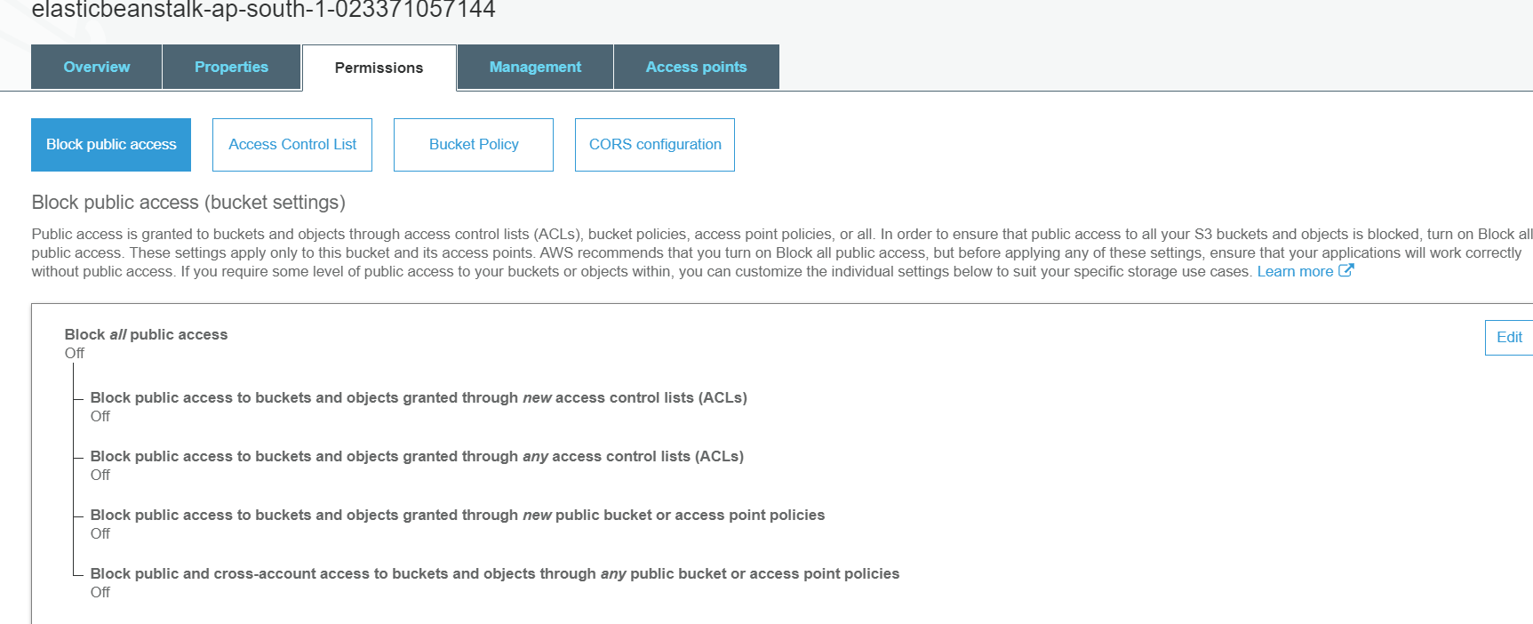
S3 Permissions: Block Public Access

Slide 14
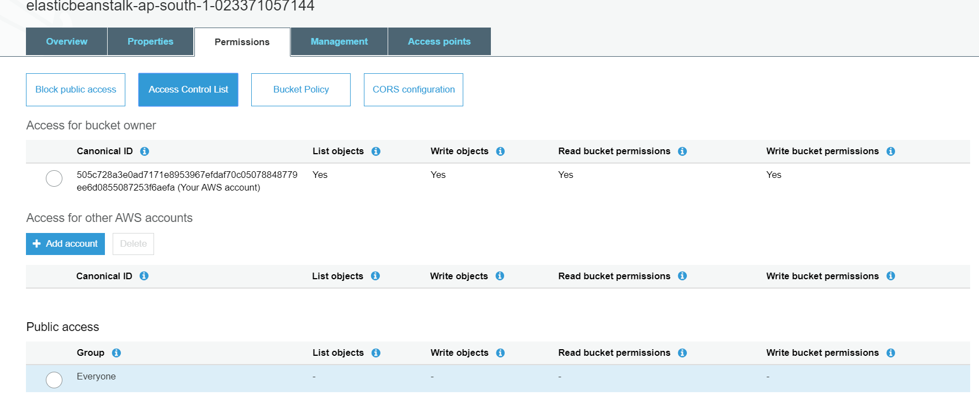
S3 Permissions: Access Control List

Slide 15
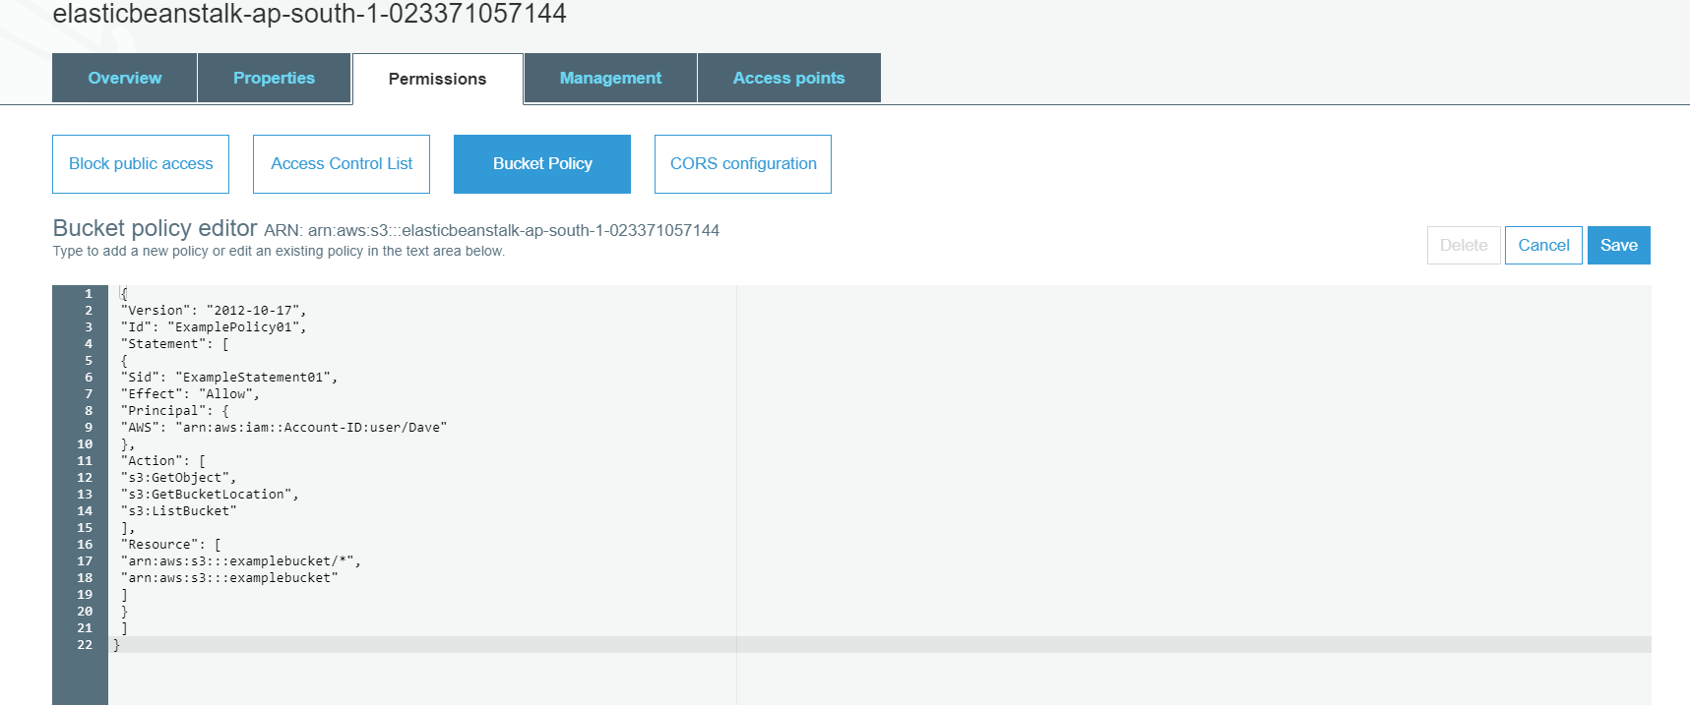
S3 Permissions: Bucket Policy

Slide 16
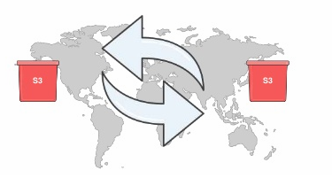
AWS S3: Cross-Region & Same Region Replication
Cross-region replication & Same Region is a bucket-level feature that enables automatic, asynchronous copying of objects across buckets in different AWS regions and same AWS Region
Amazon S3 replicates the new objects created after enabling the replication configuration.
Amazon S3 does not replicate objects in the source bucket for which the bucket owner does not have permissions.
Objects in the source bucket that are replicas, created by another cross-region replication, are not replicated.

Slide 17
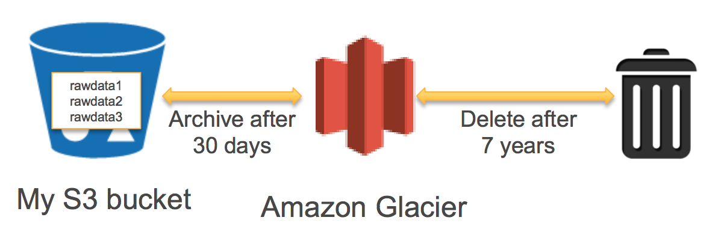
AWS S3: Life Cycle Management
Lifecycle configuration enables you to specify the lifecycle management of objects in a bucket.
These actions can be classified as follows:
Transition actions: You define when objects transition to another storage class.
Transition objects to the STANDARD_IA storage class 30 days after creation
Archive objects to the GLACIER storage class one year after creation.
Expiration actions: You specify when the objects expire.

Slide 18
THANK YOU

